Slide 1
Let’s Do This!
July 24, 2018
Toby, Nancy, Jason
Notes:
spent a lot of time talking about learning styles, Universal Design for Learning, Psychological Types etc…
read an article that seem to counter all of what we learned last week. Debated and discussed it.
watched some videos and started to develop an entire course around this all over again… we had to stop. We are only doing an opening.
However, all good discussion and we’re hoping for more this morning.

Slide 2
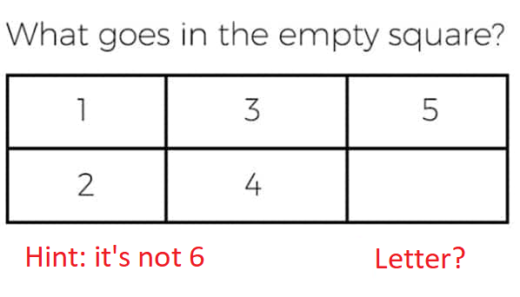
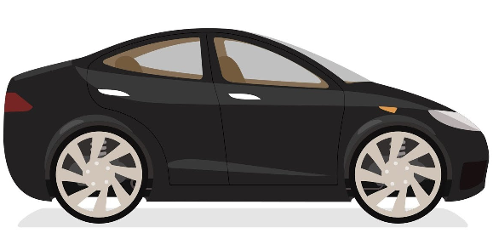

Slide 3


Slide 4
Based on your learning style:
What about your learning style helped or hindered you?
Visual, Auditory, Tactile
How does this impact the way you present material / instruct?
Notes:
Nancy –it HAD to be a number. And stopped.
Jason –wasn’t enough information and the visual was an unfair representation of the question.
Toby – Read the question but “remembered’ the question incorrectly. Included “number”

